Slide 1
Disney + Hotstar Data Analysis
Praveen Raj.G MBT 12

Slide 2
Overview
Disney+ Hotstar is an Indian streaming service that operates on a subscription video-on-demand model. It is a collaboration between Disney India and Viacom18, which is a subsidiary of Reliance Industries.
Hotstar, a streaming service from Disney Star, offers a wide array of content, including films, television series, live sports, and original programming, alongside licensed content from third parties like Showtime. Its rapid growth coincided with the expansion of mobile broadband in India, leading to its establishment as the leading streaming platform in the country.

Slide 3
Data Cleaning and Preprocessing
For this data analysis i’m using Power BI for visualization
After loading Disney+hotstar dataset in power BI, Data cleaning processed by following steps.
Error removed from Dataset
Duplicate removed
Replace null values with 0
Changed data type for Running time
Filtered rows
Sorted rows as per requirement

Slide 4
Data Visualization:
After data cleaning as per task list i started to create visualization in Power BI
In this Analysis i mostly create visualization for Movie type rather than Tv shows
As per task assigned i create only one visuals for Tv shows

Slide 5
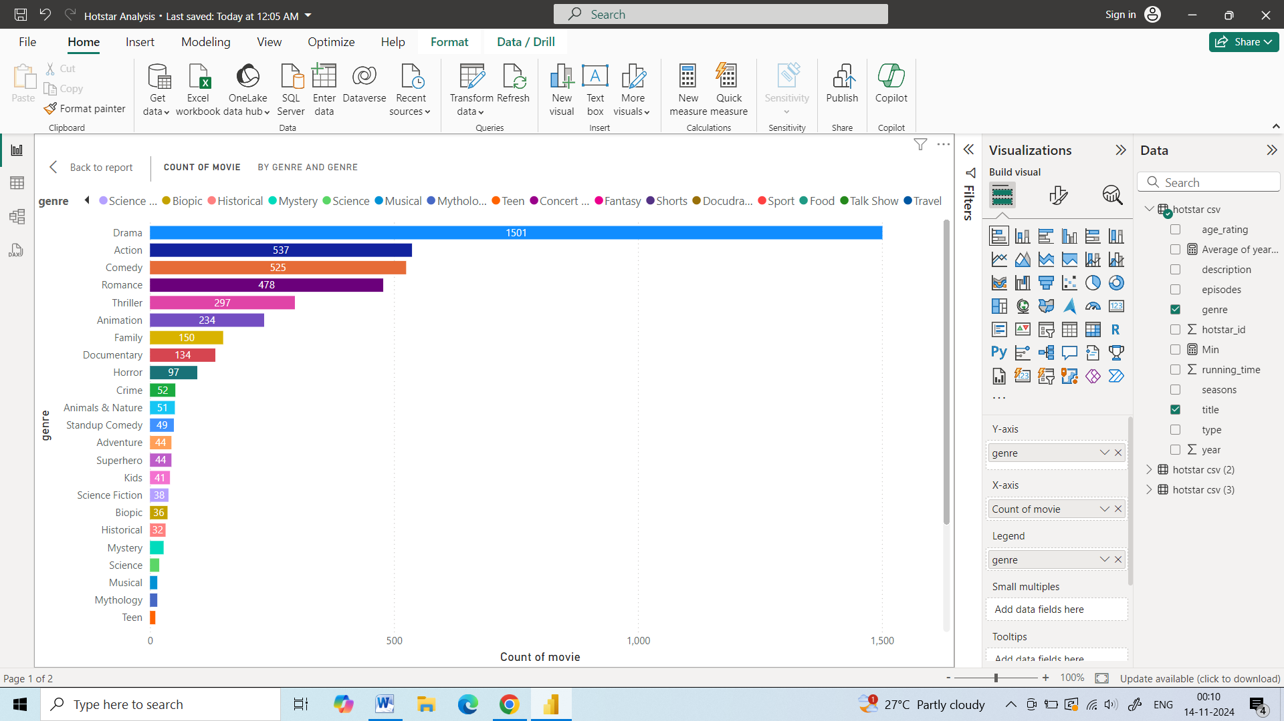
Task 1 - Movies Distribution by Genre
Genre Distribution:
Drama: The most common genre with 1501 movies.
Action: The second most common genre with 537 movies.
Comedy: The third most common genre with 525 movies.
Less Common Genres:
Genres like "Animals & Nature" and "Concert Film" have very few movies.

Slide 6
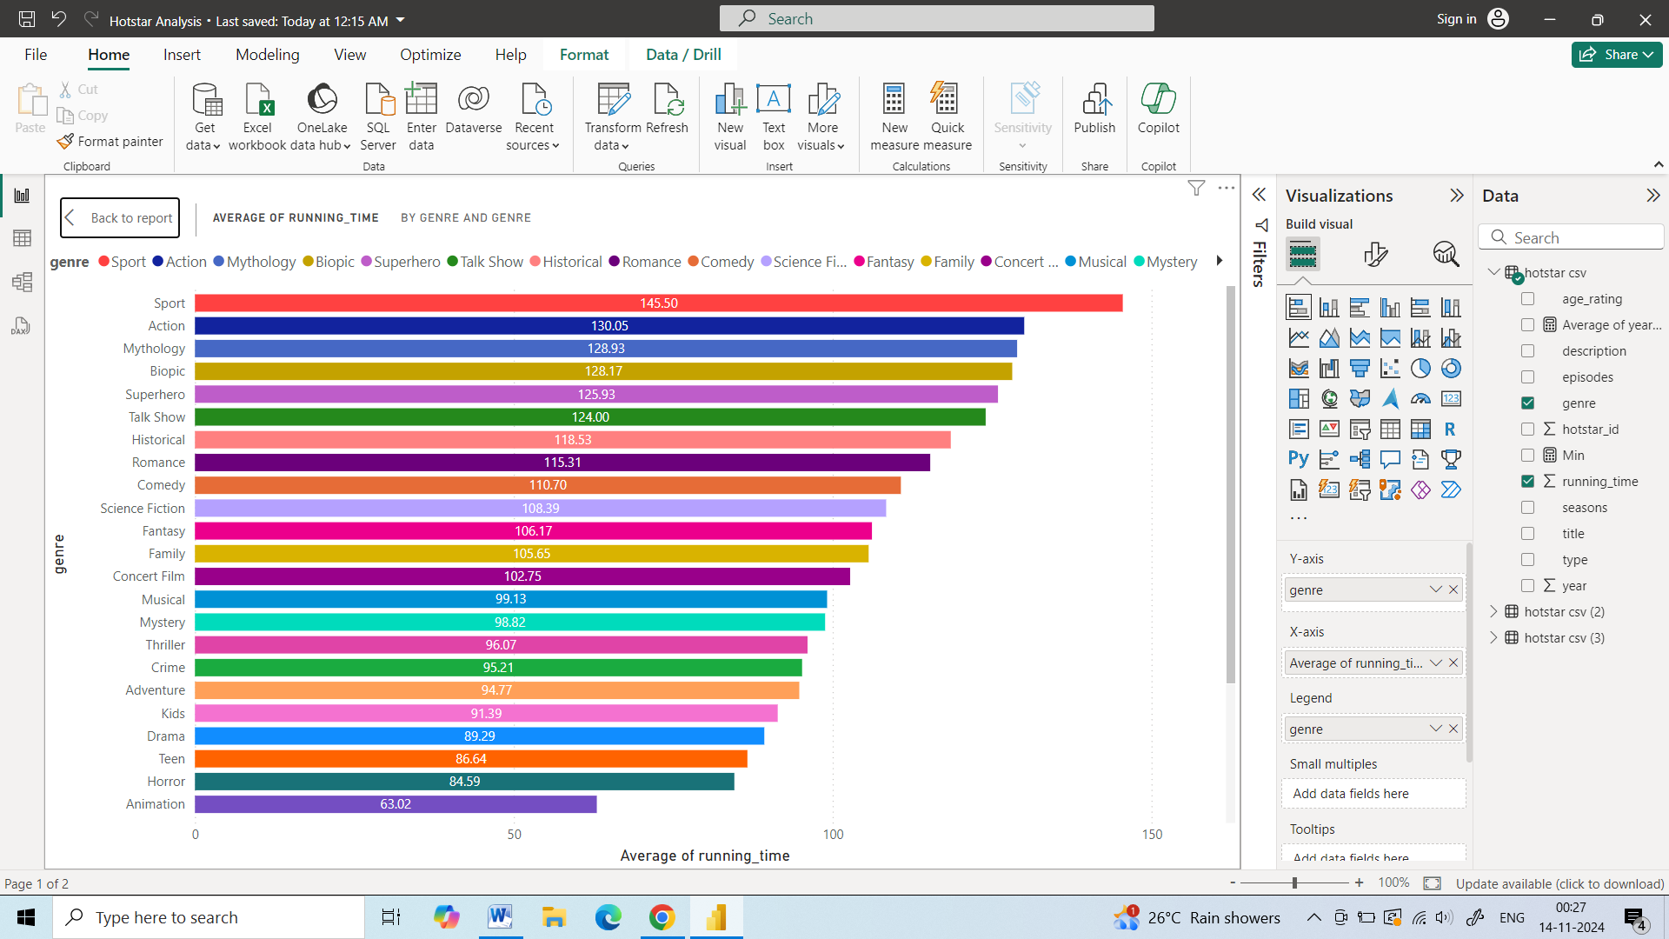
Task 2 - Average Running Time by Genre
Average Running Time:
Sport: The genre with the longest average running time at 155.9 minutes.
Mystery: The genre with the shortest average running time at 82.0 minutes.
Genre Distribution:
Genres like "Sport," "Superhero," and "Talk Show" tend to have longer average running times.
Genres like "Mystery," "Adventure," and "Drama" tend to have shorter average running times.

Slide 7
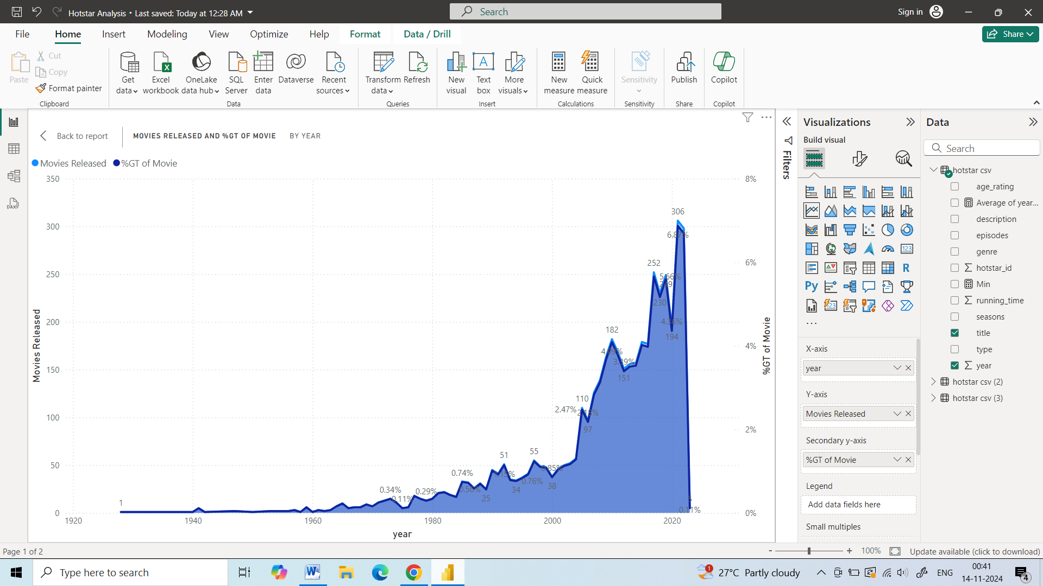
Task 3- Movies Released Each Year
Number of Movies Released:
There has been a significant increase in the number of movies released over the years.
The year with the highest number of releases is 2020, with approximately 350 movies.
The year with the lowest number of releases is 1920, with only 1 movie.
Percentage of Movies Released:
The percentage of movies released in each year has fluctuated over time.
There was a significant drop in the percentage of movies released in the early 1930s.
Trend:
The chart shows a clear upward trend in the number of movies released over time.
The percentage of movies released has been relatively stable since the 1950s.

Slide 8
Task 4 - Top 10 Longest Movie
Distribution of Running Times: The donut chart displays the distribution of average running times across different movies.
Movie with the Longest Running Time: The movie with the longest average running time is "The 2022 Rock & Roll Hall of Fame Induction Ceremony" with an average running time of 229 minutes.
Movie with the Shortest Running Time: The movie with the shortest average running time is "Arendelle Castle Yule Log: Cut Paper Edition" with an average running time of 181 minutes.
Above movies Filtered based on top 10 longest running time

Slide 9
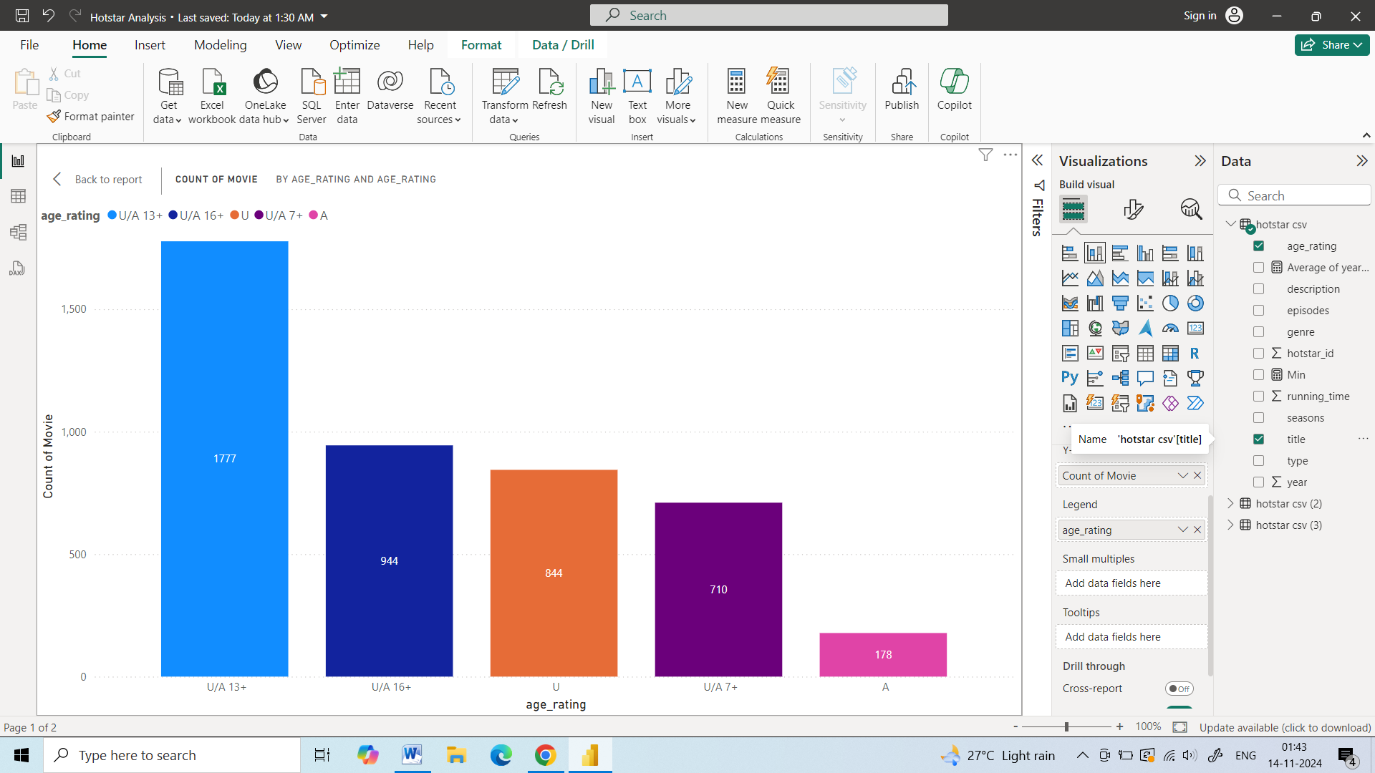
Task 5 - Movies by Age Rating
Distribution of Movies by Age Rating: The bar chart displays the distribution of movies across different age ratings.
Age Rating with the Highest Number of Movies: The age rating "U/A 13+" has the highest number of movies with 1777 movies.
Age Rating with the Lowest Number of Movies: The age rating "U/A 7+" has the lowest number of movies with 711 movies.

Slide 10
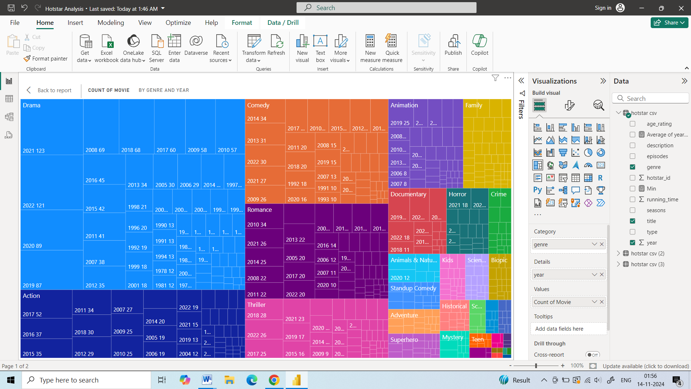
Task 6 - Count of Movies by Year and Genre
Distribution of Movies by Genre and Year: The matrix visual displays the distribution of movies across different genres and years.
Genre with the Highest Number of Movies: The genre "Drama" has the highest number of movies.
Year with the Highest Number of Movies: The year "2014" has the highest number of movies.

Slide 11
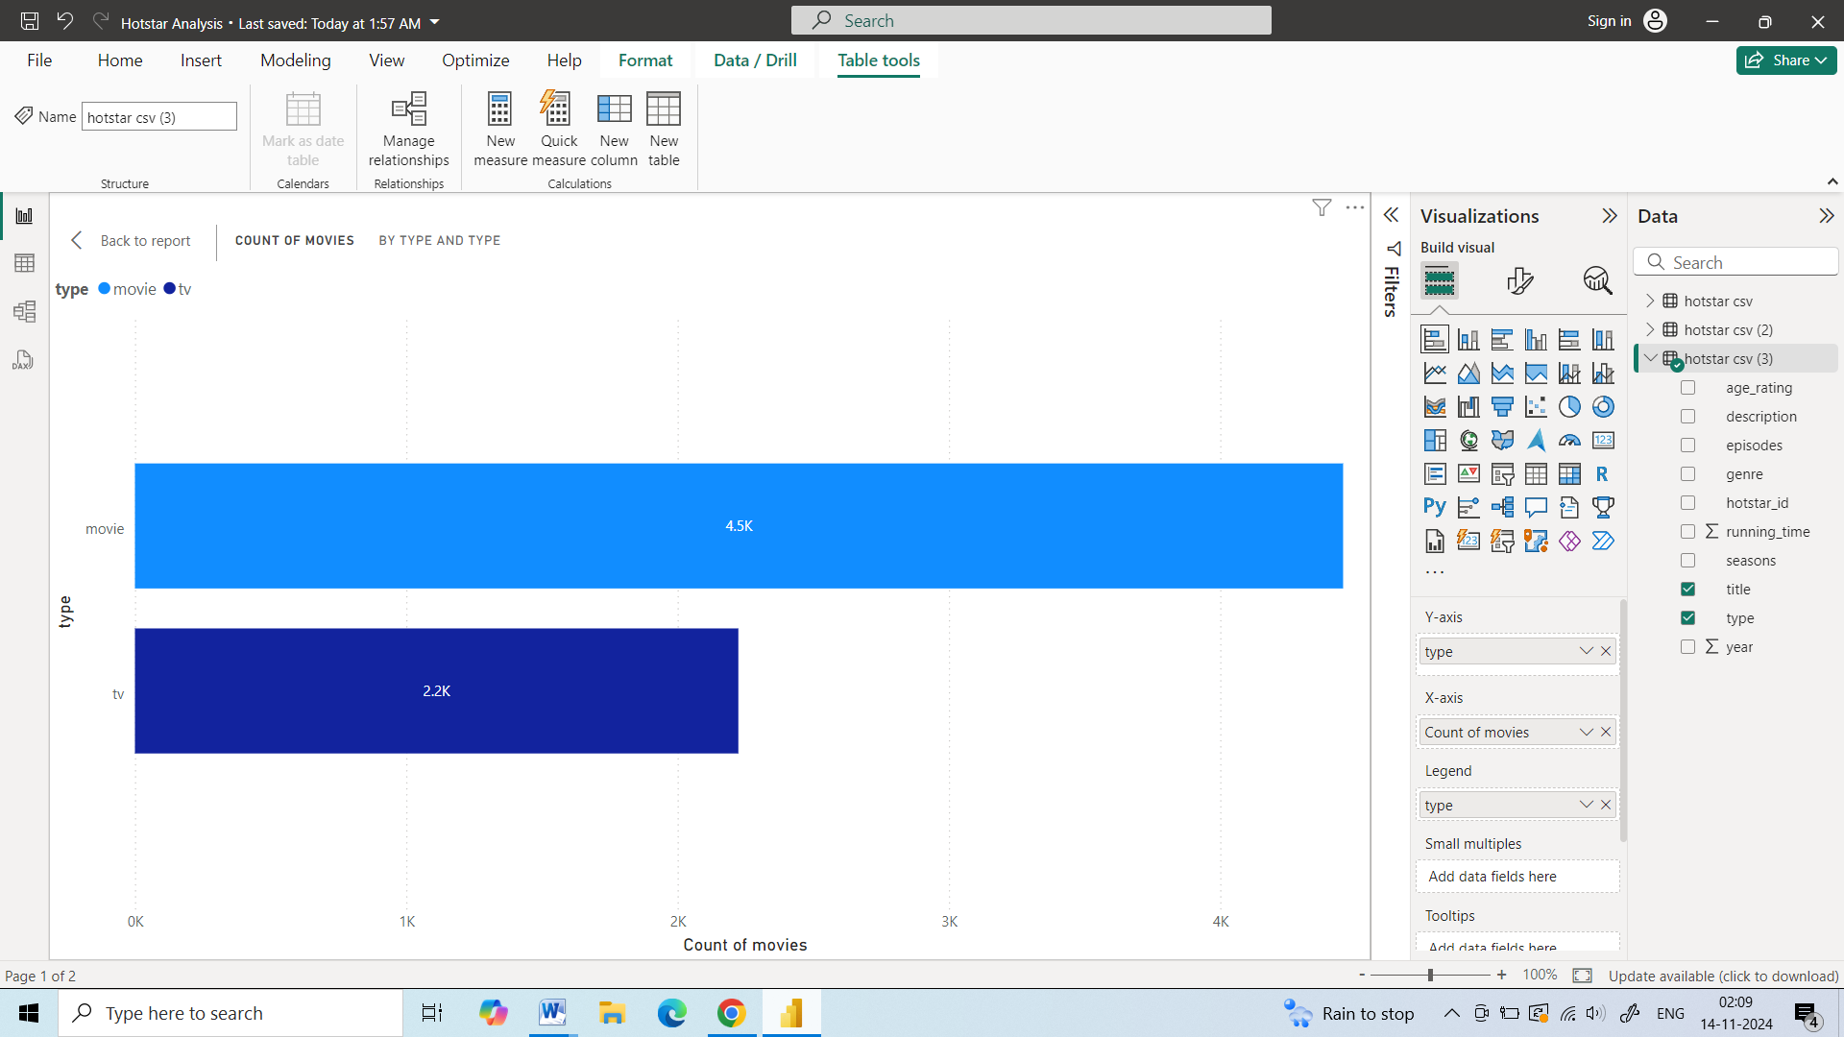
Task 7 - Most common movie type
Distribution of Movies and TV Shows: The bar chart displays the distribution of movies and TV shows in the dataset.
Type with the Highest Number of Content: The type "movie" has the highest number of content with 4453 movies.
Type with the Lowest Number of Content: The type "tv show" has a lower number of content with 2224 TV shows.

Slide 12
Task 8 - Correlation between running time and year
Distribution of Movies by Year and Running Time: The scatter plot displays the distribution of movies across different years and running times.
Trend: There appears to be a slight negative trend, indicating that movies released in later years tend to have slightly shorter running times on average. However, the trend is not very strong.
Outliers: There are a few outliers with very long running times, which might be TV series or movies with multiple episodes.
Correlation Coefficient: The correlation coefficient between the year of release and the running time is -0.39.
Strength of Correlation: The negative value indicates a negative correlation, meaning that as the year of release increases, the running time tends to decrease. However, the magnitude of the correlation is relatively low, indicating a weak correlation.

Slide 13
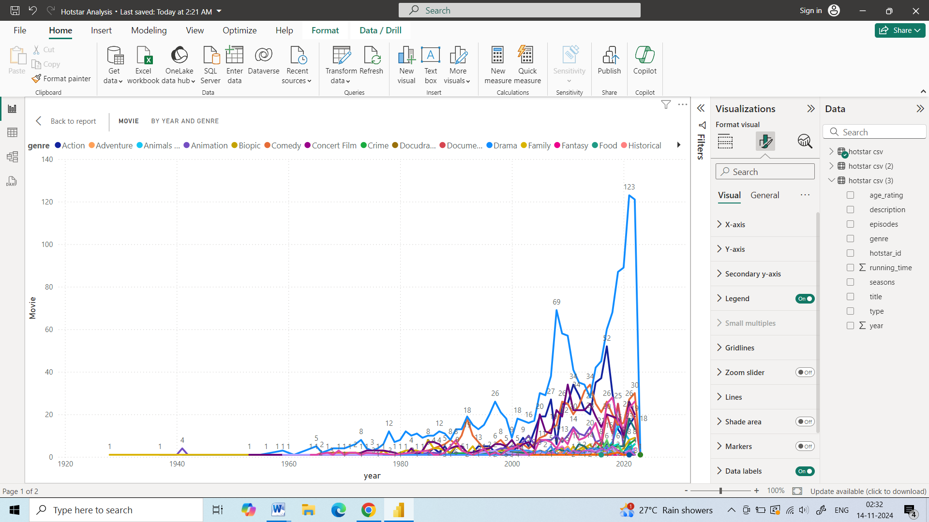
Task 9 - Genre Popularity Over Time
Distribution of Movies by Genre and Year: The line chart displays the distribution of movies across different genres and years.
Trend: The chart shows a clear upward trend in the number of movies released over the years.
Genre with the Highest Number of Movies: The genre "Drama" has the highest number of movies released over the years.

Slide 14
Task 10 - Movies by Genre and Age rating
The pattern observed in the matrix is the distribution of movies across different genres and age ratings. We can see that some genres have a higher number of movies in specific age ratings compared to others.
For example, "Drama" has a high number of movies across all age ratings, while "Animation" is primarily targeted towards younger audiences (U/A 7+).
Content Strategy: Understanding the distribution of movies by genre and age rating can help in planning content acquisition and curation strategies.
Audience Targeting: By analyzing the popularity of different genres and age ratings, platforms can target specific audiences with relevant content.
Content Gaps: Identifying genres or age ratings with fewer movies can help in filling content gaps and diversifying the library.

Slide 15
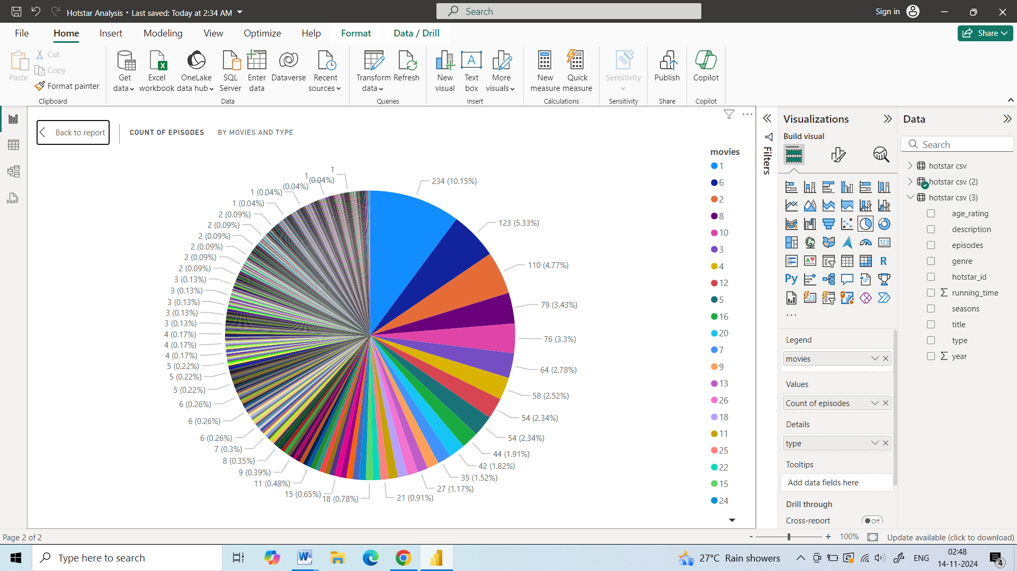
Task 11 - Tv Shows with maximum episodes
Distribution of Episodes by Movie: The pie chart displays the distribution of episodes across different movies.
Movie with the Highest Number of Episodes: The movie with the highest number of episodes is represented by the largest slice in the pie chart.
Movie with the Lowest Number of Episodes: The movies with the lowest number of episodes are represented by the smallest slices in the pie chart

Slide 16
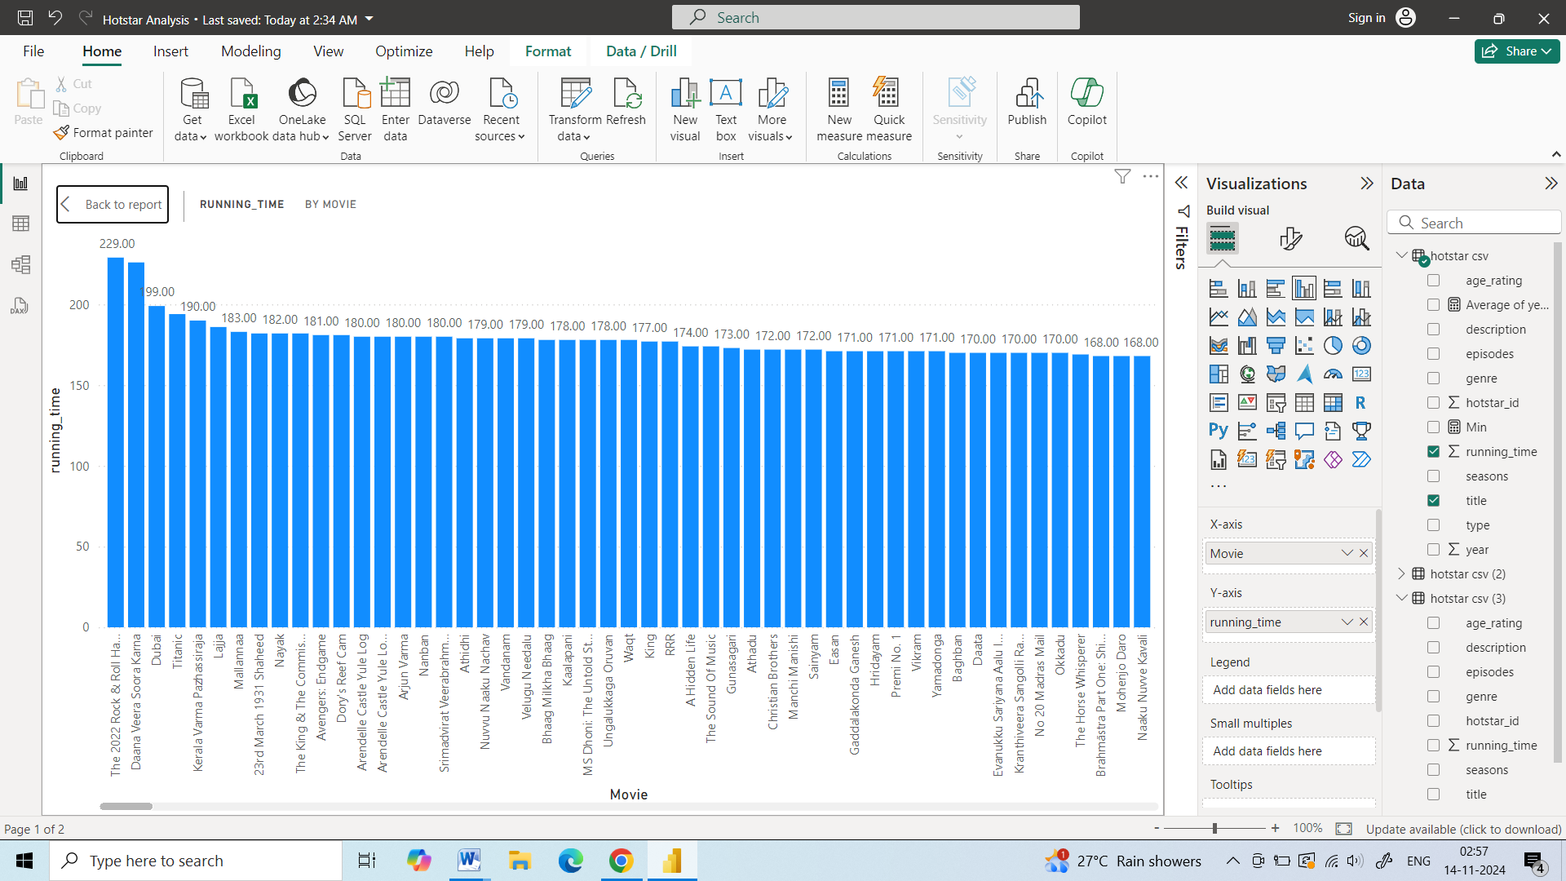
Task 12- Distribution of Running Time
Distribution of Running Times: The bar chart displays the distribution of running times across different movies.
Movie with the Longest Running Time: The movie with the longest running time is represented by the tallest bar in the chart.
Movie with the Shortest Running Time: The movie with the shortest running time is represented by the shortest bar in the chart.

Slide 17
Specific insights,Trends and Pattern
Movie Distribution:
Genre: Drama appears to be the most popular genre, followed by Action and Comedy.
Age Rating: U/A 13+ is the most common age rating for movies.
Release Year: The number of movie releases has increased over the years.
Movie Type: Movies are more prevalent than TV shows.
Running Time:
Average Running Time: The average running time varies across genres.
Movie Duration: There's a wide range of movie durations, with some movies being significantly longer than others.
Year vs. Running Time: There might be a slight negative correlation between the year of release and running time, indicating that movies are getting shorter over time.
Genre Preferences:
Genre Popularity: Certain genres like Drama, Action, and Comedy consistently have a higher number of movies.
Genre-Age Rating Combinations: Some genres are more prevalent in specific age ratings.

Slide 18
Actionable Recommendation
Content Curation:
  Personalized Recommendations: Use the data to recommend movies based on user preferences for genre, age rating, and running time.
  Themed Content Collections: Curate collections of movies based on specific themes or genres.
  Targeted Marketing: Use the data to identify target audiences for specific genres or age ratings.
User Experience:
  Dynamic Playback Options: Offer options like variable playback speed or skip intro/outro sequences to cater to different viewer preferences and time constraints.
  Adaptive Streaming: Optimize video streaming quality based on network conditions and device capabilities to ensure smooth playback.
Data-Driven Insights:
  Genre Analysis: Analyze the popularity of different genres over time.
  Audience Segmentation: Segment audiences based on their preferred genres, age ratings, and running times.
  Content Gaps: Identify genres or age ratings with fewer movies to fill content gaps.

Slide 19
Further Analysis
User Behavior Analysis: Understand how users interact with the platform, including their preferred genres, watch times, and device usage.
By leveraging the insights gained from this Power BI dashboard, we can make data-driven decisions to improve the user experience, optimize content delivery, and drive business growth.

Slide 20
Thank you

